Slide 1
Notes:
original slide show from: https://github.com/rstudio-education/master-the-tidyverse-instructors/tree/master/powerpoints
modified 2019-10-16 by Kim Cressman to incorporate pivot() functions and shorten for CERF workshop

Slide 2
"Data comes in many formats, but R prefers just one: tidy data. "
- Garrett Grolemund

Slide 3

Tidy data
country | year | cases | pop
Afghanistan | 1999 | 745 | 19987071
Afghanistan | 2000 | 2666 | 20595360
Brazil | 1999 | 37737 | 172006362
Brazil | 2000 | 80488 | 174504898
China | 1999 | 212258 | 1272915272
China | 2000 | 213766 | 1280428583
A data set is tidy iff:
Each variable is in its own column
Each case is in its own row
Each value is in its own cell
Also see these papers, in your “other resources” folder:
Wickham, 2014: Tidy Data
Broman and Woo, 2017: Data Organization in Spreadsheets

Slide 4
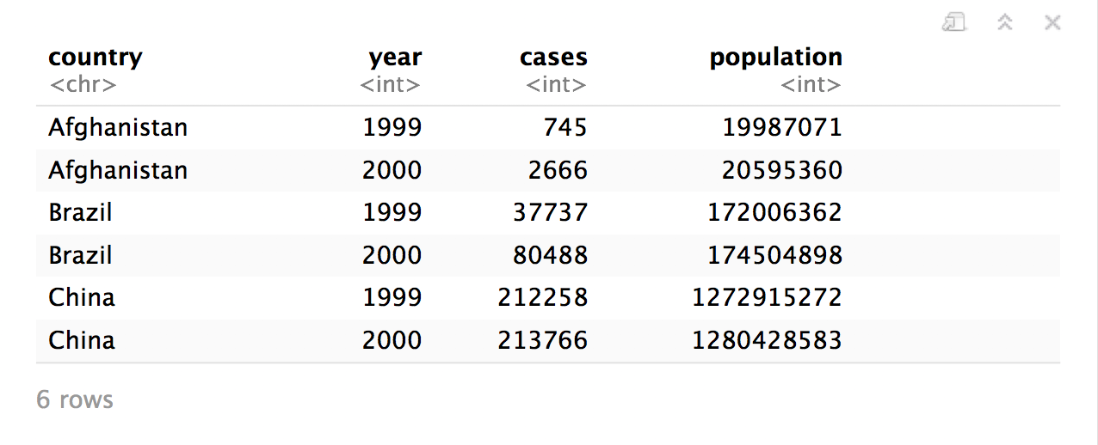
Quiz
What are the variables in this data set?
table1

Slide 5
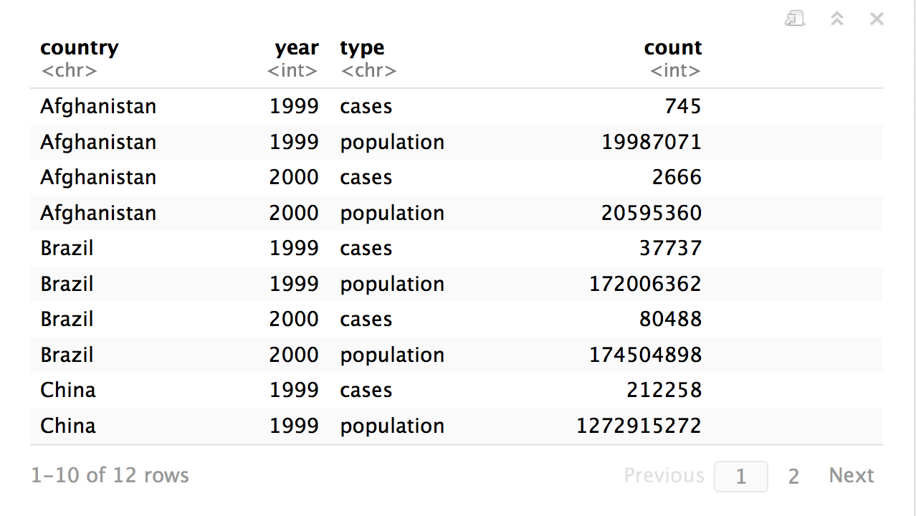
Quiz
What are the variables in this data set?
table2

Slide 6
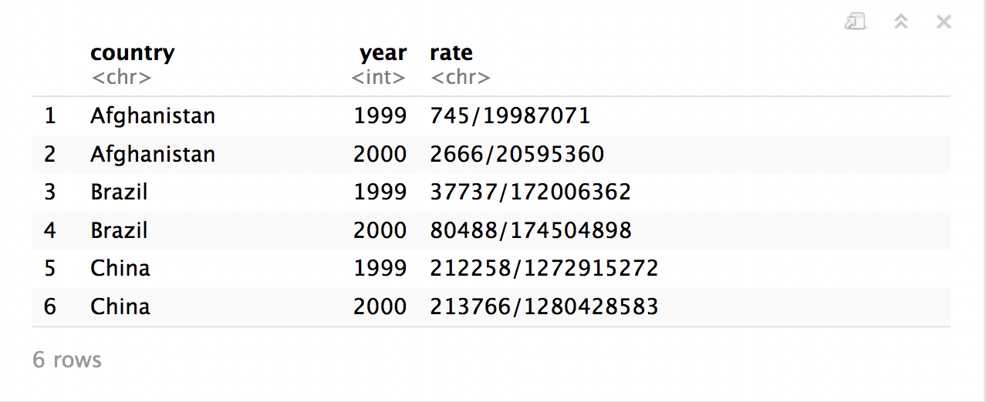
table3
CC BY-SA RStudio

Slide 7
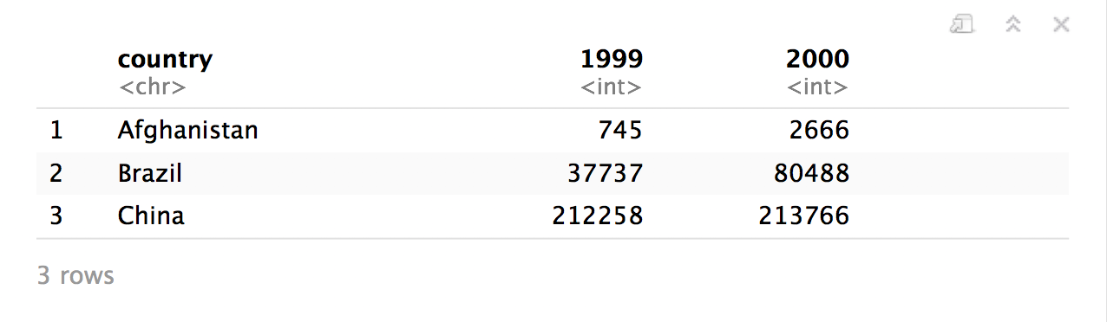
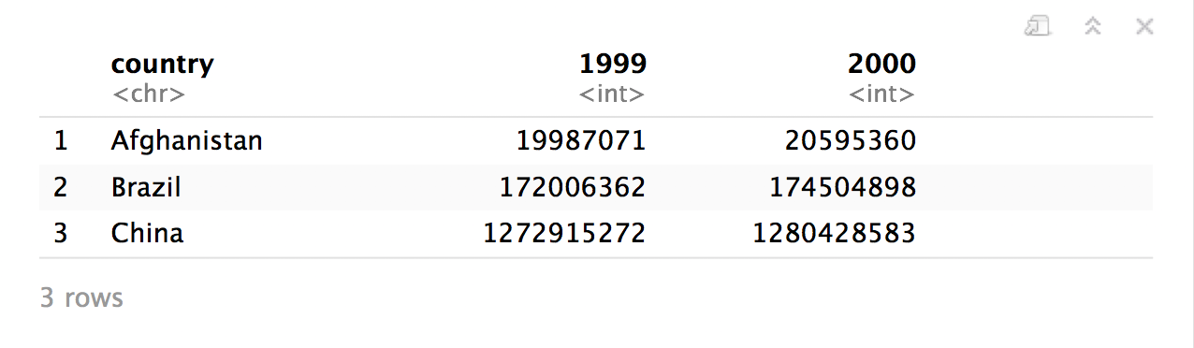
table4a
table4b
CC BY-SA RStudio

Slide 8
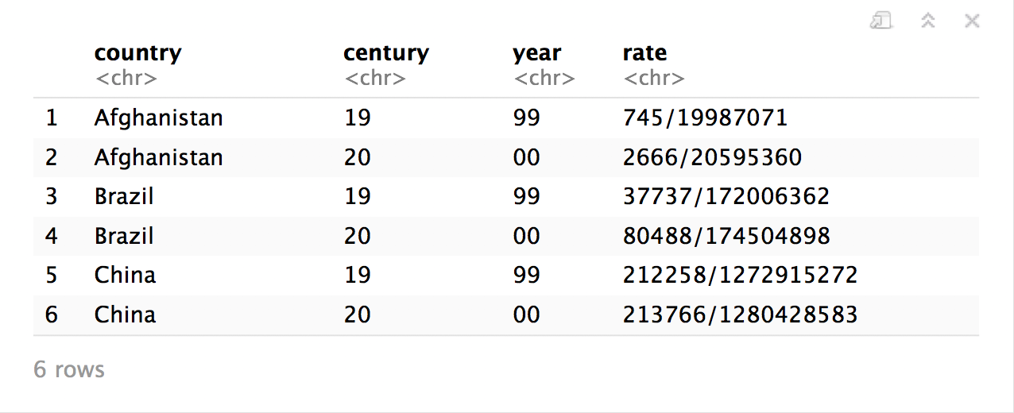
table5
CC BY-SA RStudio

Slide 9
Tidy data
country | year | cases | pop
Afghanistan | 1999 | 745 | 19987071
Afghanistan | 2000 | 2666 | 20595360
Brazil | 1999 | 37737 | 172006362
Brazil | 2000 | 80488 | 174504898
China | 1999 | 212258 | 1272915272
China | 2000 | 213766 | 1280428583
A data set is tidy iff:
Each variable is in its own column
Each case is in its own row
Each value is in its own cell

Slide 10
table1$country
table1$year
table1$cases
table1$population

Slide 11


table2$country
table2$year
table2$count[c(1,3,5,7,9,11)]
table2$count[c(2,4,6,8,10,12)]

Slide 12
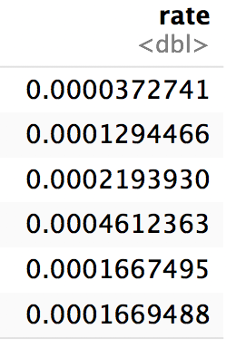
table1$cases / table1$population -> table1$rate

Slide 13
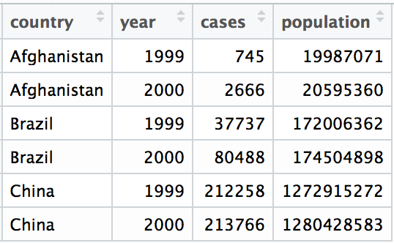
Tidy data
A data set is tidy iff:
Each variable is in its own column
Each case is in its own row
Each value is in its own cell

Slide 14
"Tidy data sets are all alike; but every messy data set is messy in its own way."
- Hadley Wickham

Slide 15

tidyr

Slide 16
tidyr
A package that reshapes the layout of tabular data.
CC BY-SA RStudio

Slide 17
pivot_longer()

Slide 18
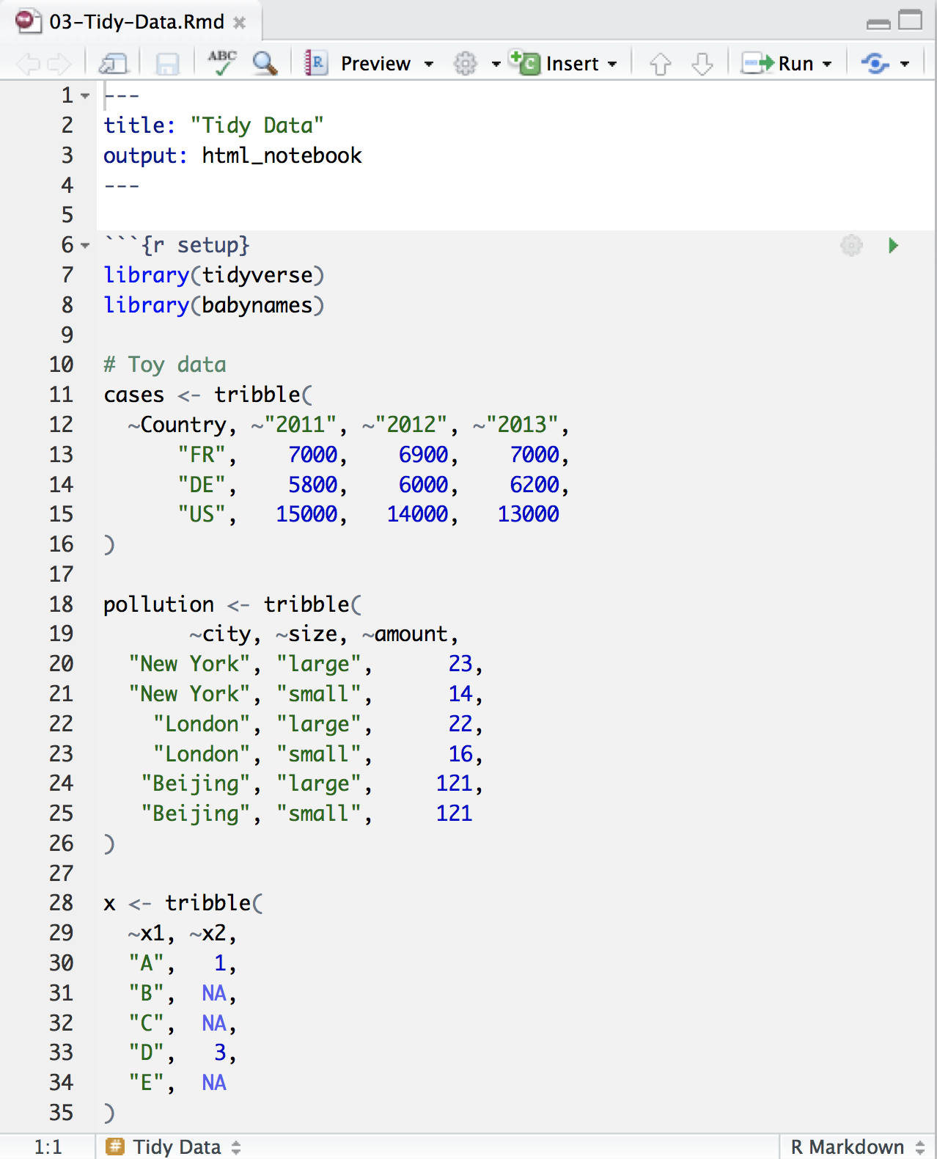
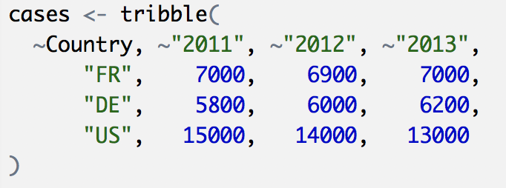
Toy data
CC BY-SA RStudio

Slide 19
Quiz
What are the variables in cases?
Country | 2011 | 2012 | 2013
FR | 7000 | 6900 | 7000
DE | 5800 | 6000 | 6200
US | 15000 | 14000 | 13000

Slide 20
Quiz
What are the variables in cases?
Country | 2011 | 2012 | 2013
FR | 7000 | 6900 | 7000
DE | 5800 | 6000 | 6200
US | 15000 | 14000 | 13000
Country
Year
Count

Slide 21
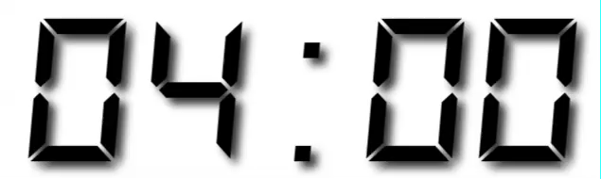
Your Turn 1
On a sheet of paper, draw how the cases data set would look if it had the same values grouped into three columns: country, year, n
Country | 2011 | 2012 | 2013
FR | 7000 | 6900 | 7000
DE | 5800 | 6000 | 6200
US | 15000 | 14000 | 13000

Slide 22
Country | 2011 | 2012 | 2013
FR | 7000 | 6900 | 7000
DE | 5800 | 6000 | 6200
US | 15000 | 14000 | 13000
CC BY-SA RStudio

Slide 23
Country | 2011 | 2012 | 2013
FR | 7000 | 6900 | 7000
DE | 5800 | 6000 | 6200
US | 15000 | 14000 | 13000
Country | Year | n
FR | 2011 | 7000
DE | 2011 | 5800
US | 2011 | 15000
FR | 2012 | 6900
DE | 2012 | 6000
US | 2012 | 14000
FR | 2013 | 7000
DE | 2013 | 6200
US | 2013 | 13000
CC BY-SA RStudio

Slide 24
Country | 2011 | 2012 | 2013
FR | 7000 | 6900 | 7000
DE | 5800 | 6000 | 6200
US | 15000 | 14000 | 13000
Country | Year | n
FR | 2011 | 7000
DE | 2011 | 5800
US | 2011 | 15000
FR | 2012 | 6900
DE | 2012 | 6000
US | 2012 | 14000
FR | 2013 | 7000
DE | 2013 | 6200
US | 2013 | 13000
CC BY-SA RStudio

Slide 25
Country | 2011 | 2012 | 2013
FR | 7000 | 6900 | 7000
DE | 5800 | 6000 | 6200
US | 15000 | 14000 | 13000
Country | Year | n
FR | 2011 | 7000
DE | 2011 | 5800
US | 2011 | 15000
FR | 2012 | 6900
DE | 2012 | 6000
US | 2012 | 14000
FR | 2013 | 7000
DE | 2013 | 6200
US | 2013 | 13000
CC BY-SA RStudio

Slide 26
Country | 2011 | 2012 | 2013
FR | 7000 | 6900 | 7000
DE | 5800 | 6000 | 6200
US | 15000 | 14000 | 13000
Country | Year | n
FR | 2011 | 7000
DE | 2011 | 5800
US | 2011 | 15000
FR | 2012 | 6900
DE | 2012 | 6000
US | 2012 | 14000
FR | 2013 | 7000
DE | 2013 | 6200
US | 2013 | 13000
CC BY-SA RStudio

Slide 27
Country | 2011 | 2012 | 2013
FR | 7000 | 6900 | 7000
DE | 5800 | 6000 | 6200
US | 15000 | 14000 | 13000
Country | Year | n
FR | 2011 | 7000
DE | 2011 | 5800
US | 2011 | 15000
FR | 2012 | 6900
DE | 2012 | 6000
US | 2012 | 14000
FR | 2013 | 7000
DE | 2013 | 6200
US | 2013 | 13000
CC BY-SA RStudio

Slide 28
Country | 2011 | 2012 | 2013
FR | 7000 | 6900 | 7000
DE | 5800 | 6000 | 6200
US | 15000 | 14000 | 13000
Country | Year | n
FR | 2011 | 7000
DE | 2011 | 5800
US | 2011 | 15000
FR | 2012 | 6900
DE | 2012 | 6000
US | 2012 | 14000
FR | 2013 | 7000
DE | 2013 | 6200
US | 2013 | 13000
CC BY-SA RStudio

Slide 29
Country | 2011 | 2012 | 2013
FR | 7000 | 6900 | 7000
DE | 5800 | 6000 | 6200
US | 15000 | 14000 | 13000
Country | Year | n
FR | 2011 | 7000
DE | 2011 | 5800
US | 2011 | 15000
FR | 2012 | 6900
DE | 2012 | 6000
US | 2012 | 14000
FR | 2013 | 7000
DE | 2013 | 6200
US | 2013 | 13000
CC BY-SA RStudio

Slide 30
Country | 2011 | 2012 | 2013
FR | 7000 | 6900 | 7000
DE | 5800 | 6000 | 6200
US | 15000 | 14000 | 13000
Country | Year | n
FR | 2011 | 7000
DE | 2011 | 5800
US | 2011 | 15000
FR | 2012 | 6900
DE | 2012 | 6000
US | 2012 | 14000
FR | 2013 | 7000
DE | 2013 | 6200
US | 2013 | 13000
CC BY-SA RStudio

Slide 31
Country | 2011 | 2012 | 2013
FR | 7000 | 6900 | 7000
DE | 5800 | 6000 | 6200
US | 15000 | 14000 | 13000
Country | Year | n
FR | 2011 | 7000
DE | 2011 | 5800
US | 2011 | 15000
FR | 2012 | 6900
DE | 2012 | 6000
US | 2012 | 14000
FR | 2013 | 7000
DE | 2013 | 6200
US | 2013 | 13000
CC BY-SA RStudio

Slide 32
Country | 2011 | 2012 | 2013
FR | 7000 | 6900 | 7000
DE | 5800 | 6000 | 6200
US | 15000 | 14000 | 13000
Country | Year | n
FR | 2011 | 7000
DE | 2011 | 5800
US | 2011 | 15000
FR | 2012 | 6900
DE | 2012 | 6000
US | 2012 | 14000
FR | 2013 | 7000
DE | 2013 | 6200
US | 2013 | 13000
CC BY-SA RStudio

Slide 33
Country | 2011 | 2012 | 2013
FR | 7000 | 6900 | 7000
DE | 5800 | 6000 | 6200
US | 15000 | 14000 | 13000
Country | Year | n
FR | 2011 | 7000
DE | 2011 | 5800
US | 2011 | 15000
FR | 2012 | 6900
DE | 2012 | 6000
US | 2012 | 14000
FR | 2013 | 7000
DE | 2013 | 6200
US | 2013 | 13000
CC BY-SA RStudio

Slide 34
Country | 2011 | 2012 | 2013
FR | 7000 | 6900 | 7000
DE | 5800 | 6000 | 6200
US | 15000 | 14000 | 13000
Country | Year | n
FR | 2011 | 7000
DE | 2011 | 5800
US | 2011 | 15000
FR | 2012 | 6900
DE | 2012 | 6000
US | 2012 | 14000
FR | 2013 | 7000
DE | 2013 | 6200
US | 2013 | 13000
pivot_longer()
CC BY-SA RStudio

Slide 35
1
2
Country | 2011 | 2012 | 2013
FR | 7000 | 6900 | 7000
DE | 5800 | 6000 | 6200
US | 15000 | 14000 | 13000
Country | Year | n
FR | 2011 | 7000
DE | 2011 | 5800
US | 2011 | 15000
FR | 2012 | 6900
DE | 2012 | 6000
US | 2012 | 14000
FR | 2013 | 7000
DE | 2013 | 6200
US | 2013 | 13000
CC BY-SA RStudio

Slide 36
names_to (former column names)
Country | 2011 | 2012 | 2013
FR | 7000 | 6900 | 7000
DE | 5800 | 6000 | 6200
US | 15000 | 14000 | 13000
Country | Year | n
FR | 2011 | 7000
DE | 2011 | 5800
US | 2011 | 15000
FR | 2012 | 6900
DE | 2012 | 6000
US | 2012 | 14000
FR | 2013 | 7000
DE | 2013 | 6200
US | 2013 | 13000
CC BY-SA RStudio

Slide 37
values_to (former cells)
Country | 2011 | 2012 | 2013
FR | 7000 | 6900 | 7000
DE | 5800 | 6000 | 6200
US | 15000 | 14000 | 13000
Country | Year | n
FR | 2011 | 7000
DE | 2011 | 5800
US | 2011 | 15000
FR | 2012 | 6900
DE | 2012 | 6000
US | 2012 | 14000
FR | 2013 | 7000
DE | 2013 | 6200
US | 2013 | 13000
CC BY-SA RStudio

Slide 38
pivot_longer()
cases %>% pivot_longer(cols = 2:4, names_to = "year", values_to = "n")
data frame to reshape
numeric indices of columns to collapse
(or names)
name of the new key column
(a character string)
name of the new value column
(a character string)

Slide 39
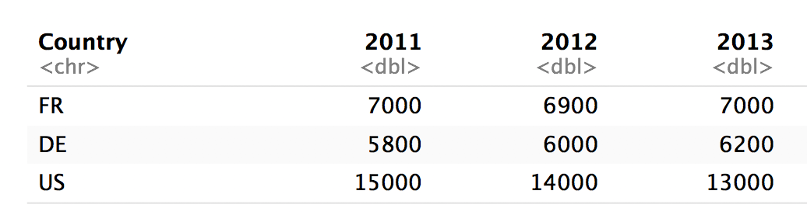
pivot_longer()
cases %>% pivot_longer(2:4, "year", "n")
numeric indices
2
3
4

Slide 40
pivot_longer()
cases %>% pivot_longer(c("2011", "2012", "2013"), "year", "n")
names
2011
2012
2013

Slide 41
pivot_longer()
cases %>% pivot_longer(-Country, "year","n")
Everything except…
Not Country
Not Country
Not Country

Slide 42
pivot_longer()
cases %>% pivot_longer(2:4, "year", "n")
cases %>% pivot_longer(c("2011", "2012", "2013"), "year", "n")
cases %>% pivot_longer(starts_with("201"), "year", "n")
cases %>% pivot_longer(-Country, "year","n")

Slide 43
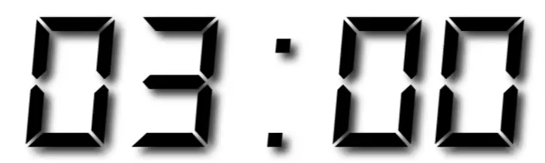
Your Turn 2
Use pivot_longer() to reorganize table4a into three columns: country, year, and cases.
Notes:
table4a is a built-in dataset

Slide 44
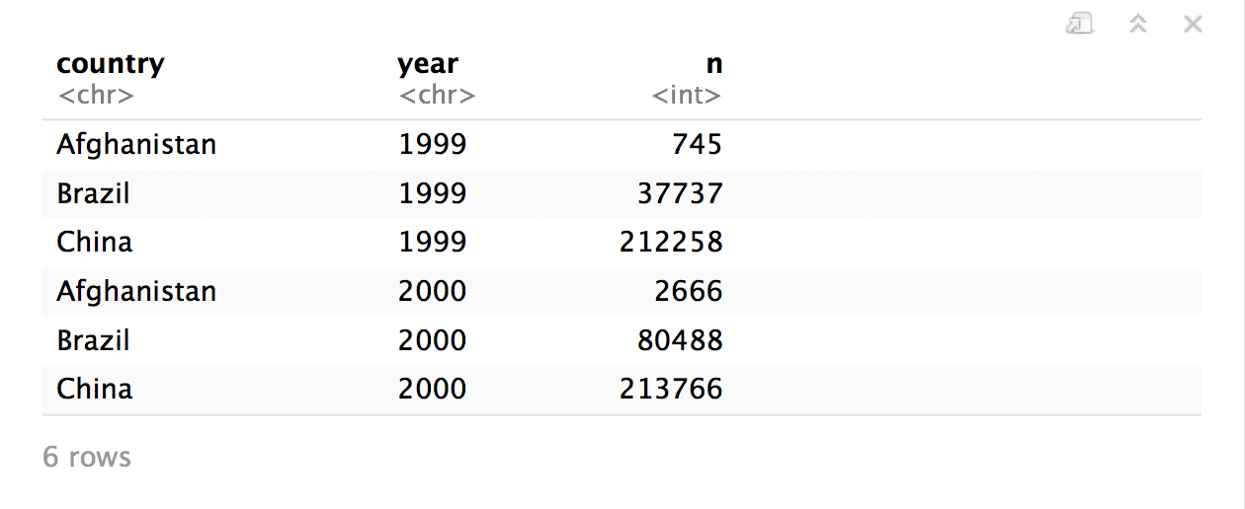
table4a %>%
pivot_longer(cols = 2:3, names_to = "year", values_to = "n")

Slide 45
pivot_wider()

Slide 46
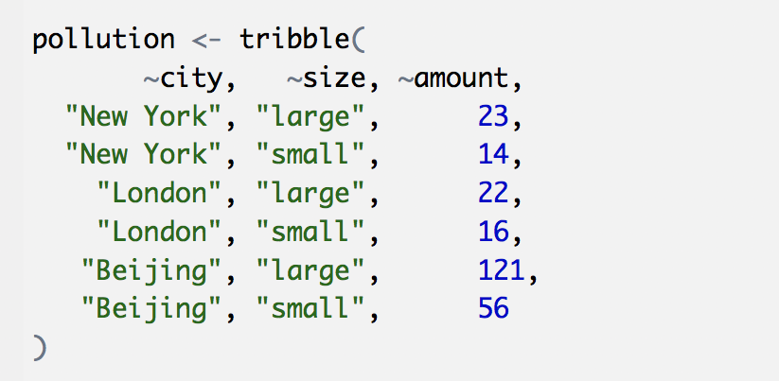
Toy data
CC BY-SA RStudio

Slide 47
Quiz
What are the variables in pollution?
city | particle size | amount (µg/m³)
New York | large | 23
New York | small | 14
London | large | 22
London | small | 16
Beijing | large | 121
Beijing | small | 56

Slide 48

Quiz
What are the variables in pollution?
city | particle size | amount (µg/m³)
New York | large | 23
New York | small | 14
London | large | 22
London | small | 16
Beijing | large | 121
Beijing | small | 56
City
Amount of large particulate
Amount of small particulate

Slide 49
Your Turn 3
On a sheet of paper, draw how this data set would look if it had the same values grouped into three columns: city, large, small
city | size | amount
New York | large | 23
New York | small | 14
London | large | 22
London | small | 16
Beijing | large | 121
Beijing | small | 56

Slide 50
city | size | amount
New York | large | 23
New York | small | 14
London | large | 22
London | small | 16
Beijing | large | 121
Beijing | small | 56
CC BY-SA RStudio

Slide 51
city | size | amount
New York | large | 23
New York | small | 14
London | large | 22
London | small | 16
Beijing | large | 121
Beijing | small | 56
city | large | small
New York | 23 | 14
London | 22 | 16
Beijing | 121 | 56
CC BY-SA RStudio

Slide 52
city | size | amount
New York | large | 23
New York | small | 14
London | large | 22
London | small | 16
Beijing | large | 121
Beijing | small | 56
city | large | small
New York | 23 | 14
London | 22 | 16
Beijing | 121 | 56
CC BY-SA RStudio

Slide 53
city | size | amount
New York | large | 23
New York | small | 14
London | large | 22
London | small | 16
Beijing | large | 121
Beijing | small | 56
city | large | small
New York | 23 | 14
London | 22 | 16
Beijing | 121 | 56
CC BY-SA RStudio

Slide 54
city | size | amount
New York | large | 23
New York | small | 14
London | large | 22
London | small | 16
Beijing | large | 121
Beijing | small | 56
city | large | small
New York | 23 | 14
London | 22 | 16
Beijing | 121 | 56
CC BY-SA RStudio

Slide 55
city | size | amount
New York | large | 23
New York | small | 14
London | large | 22
London | small | 16
Beijing | large | 121
Beijing | small | 56
city | large | small
New York | 23 | 14
London | 22 | 16
Beijing | 121 | 56
CC BY-SA RStudio

Slide 56
city | size | amount
New York | large | 23
New York | small | 14
London | large | 22
London | small | 16
Beijing | large | 121
Beijing | small | 56
city | large | small
New York | 23 | 14
London | 22 | 16
Beijing | 121 | 56
CC BY-SA RStudio

Slide 57
city | size | amount
New York | large | 23
New York | small | 14
London | large | 22
London | small | 16
Beijing | large | 121
Beijing | small | 56
city | large | small
New York | 23 | 14
London | 22 | 16
Beijing | 121 | 56
CC BY-SA RStudio

Slide 58
city | size | amount
New York | large | 23
New York | small | 14
London | large | 22
London | small | 16
Beijing | large | 121
Beijing | small | 56
city | large | small
New York | 23 | 14
London | 22 | 16
Beijing | 121 | 56
CC BY-SA RStudio

Slide 59
city | size | amount
New York | large | 23
New York | small | 14
London | large | 22
London | small | 16
Beijing | large | 121
Beijing | small | 56
pivot_wider()
city | large | small
New York | 23 | 14
London | 22 | 16
Beijing | 121 | 56
CC BY-SA RStudio

Slide 60
1
2
city | size | amount
New York | large | 23
New York | small | 14
London | large | 22
London | small | 16
Beijing | large | 121
Beijing | small | 56
city | large | small
New York | 23 | 14
London | 22 | 16
Beijing | 121 | 56
CC BY-SA RStudio

Slide 61
names_from (new column names)
city | size | amount
New York | large | 23
New York | small | 14
London | large | 22
London | small | 16
Beijing | large | 121
Beijing | small | 56
city | large | small
New York | 23 | 14
London | 22 | 16
Beijing | 121 | 56
CC BY-SA RStudio

Slide 62
values_from (new cells)
city | size | amount
New York | large | 23
New York | small | 14
London | large | 22
London | small | 16
Beijing | large | 121
Beijing | small | 56
city | large | small
New York | 23 | 14
London | 22 | 16
Beijing | 121 | 56
CC BY-SA RStudio

Slide 63
pivot_wider()
pollution %>% pivot_wider(names_from = size, values_from = amount)
data frame to reshape
column to use for keys (becomes new
column names)
column to use for values
(becomes new
column cells)

Slide 64
pollution %>% pivot_wider(names_from = size, values_from = amount)
city | size | amount
New York | large | 23
New York | small | 14
London | large | 22
London | small | 16
Beijing | large | 121
Beijing | small | 56
city | large | small
New York | 23 | 14
London | 22 | 16
Beijing | 121 | 56
CC BY-SA RStudio

Slide 65
Your Turn 4
Use pivot_wider() to reorganize table2 into four columns: country, year, cases, and population.

Slide 66
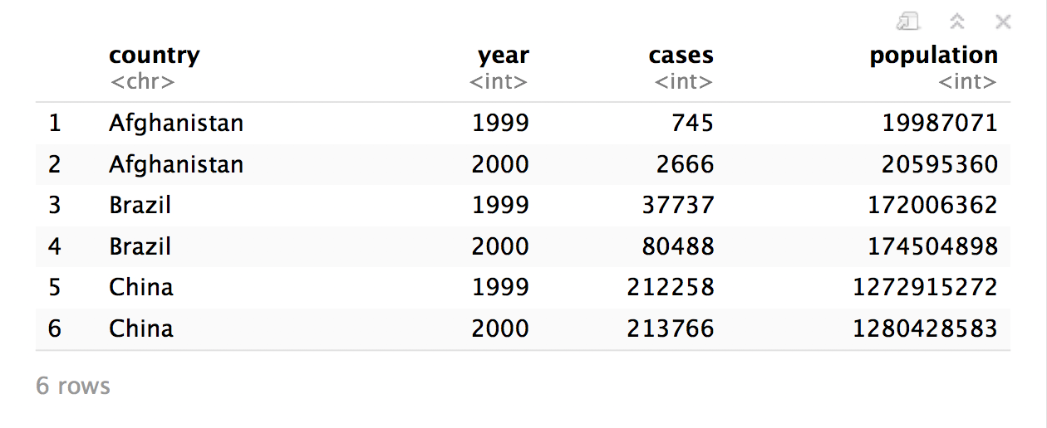
table2 %>%
pivot_wider(names_from = type, values_from = count)

Slide 68
Reshaping
Final Exam

Slide 69
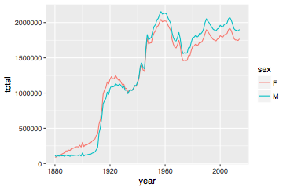
Number of children by year and gender
CC BY-SA RStudio

Slide 70
Can we calculate the ratio of boys to girls?
babynames %>%
group_by(year, sex) %>%
summarise(n = sum(n))
year sex n
<dbl> <chr> <int>
1 1880 F 90993
2 1880 M 110491
3 1881 F 91954
4 1881 M 100745
5 1882 F 107850
6 1882 M 113688
7 1883 F 112321
8 1883 M 104629
9 1884 F 129022
10 1884 M 114445
# ... with 260 more rows
CC BY-SA RStudio

Slide 71
Can we calculate the ratio of boys to girls?
babynames %>%
group_by(year, sex) %>%
summarise(n = sum(n))
year sex n
<dbl> <chr> <int>
1 1880 F 90993
2 1880 M 110491
3 1881 F 91954
4 1881 M 100745
5 1882 F 107850
6 1882 M 113688
7 1883 F 112321
8 1883 M 104629
9 1884 F 129022
10 1884 M 114445
# ... with 260 more rows
Now what?
CC BY-SA RStudio

Slide 72
Can we calculate the ratio of boys to girls?
better_layout %>%
mutate(percent_male = M / (M + F) * 100)
year sex n
<dbl> <chr> <int>
1 1880 F 90993
2 1880 M 110491
3 1881 F 91954
4 1881 M 100745
5 1882 F 107850
6 1882 M 113688
7 1883 F 112321
8 1883 M 104629
9 1884 F 129022
10 1884 M 114445
# ... with 260 more rows
year F M
* <dbl> <int> <int>
1 1880 90993 110491
2 1881 91954 100745
3 1882 107850 113688
4 1883 112321 104629
5 1884 129022 114445
6 1885 133055 107800
7 1886 144535 110784
8 1887 145982 101414
9 1888 178627 120853
10 1889 178366 110584
?
CC BY-SA RStudio

Slide 73
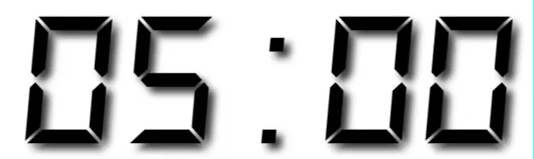
Your Turn 7
Reshape the layout of this data. Calculate the percent of male (or female) children by year. Then plot the percent over time.
babynames %>%
group_by(year, sex) %>%
summarise(n = sum(n))

Slide 74
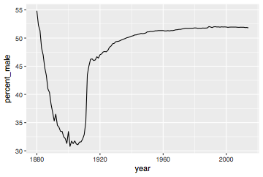
babynames %>%
group_by(year, sex) %>%
summarise(n = sum(n)) %>%
spread(sex, n) %>%
mutate(percent_male = M / (M + F) * 100) %>%
ggplot(aes(year, percent_male)) + geom_line()
CC BY-SA RStudio

Slide 75
Percent of children that are male by year
CC BY-SA RStudio

Slide 76
Section

Slide 77
Code
HTTP Verb
HTTP version
URL path
URL path
GET /resources/webinars/ HTTP/1.1
Host: www.rstudio.com
User-Agent: libcurl/7.43.0 r-curl/2.1 httr/1.2.1
Accept-Encoding: gzip, deflate
Accept: application/json, text/xml, application/xml, */*
CC BY-SA RStudio

Slide 78
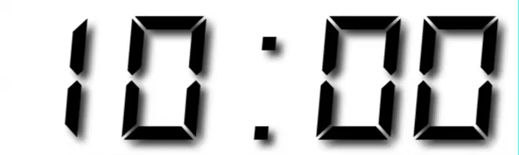
Your Turn
Open R. Then download the packages that we will use today by running the following code.

Slide 79
Sub section

Slide 80
CC BY-SA RStudio

Slide 81









Technical Diagram
Shiny Server Pro
Production
Data Scientists
RStudio IDE
End Users
Web Browsers
Sticky Load Balancer
Staging
Data Stores
File Share
Data Mart

Slide 82





















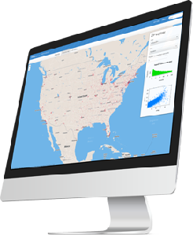
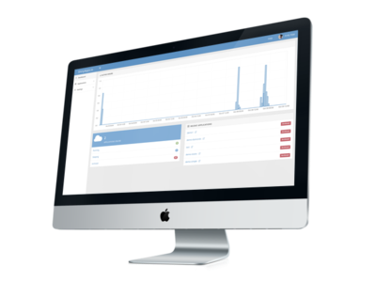



















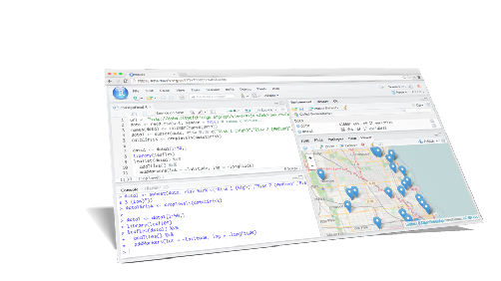
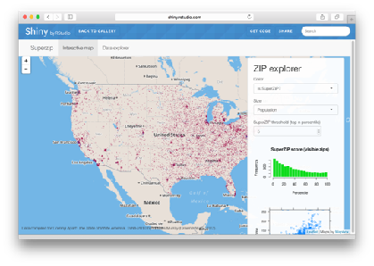






Icons
Hardware
Software
Packages
Architecture
dplyr
0.4
+
SYSTEM LIBRARY

Slide 83


Hardware
Software
Packages
Architecture

rvest

